Slide 1
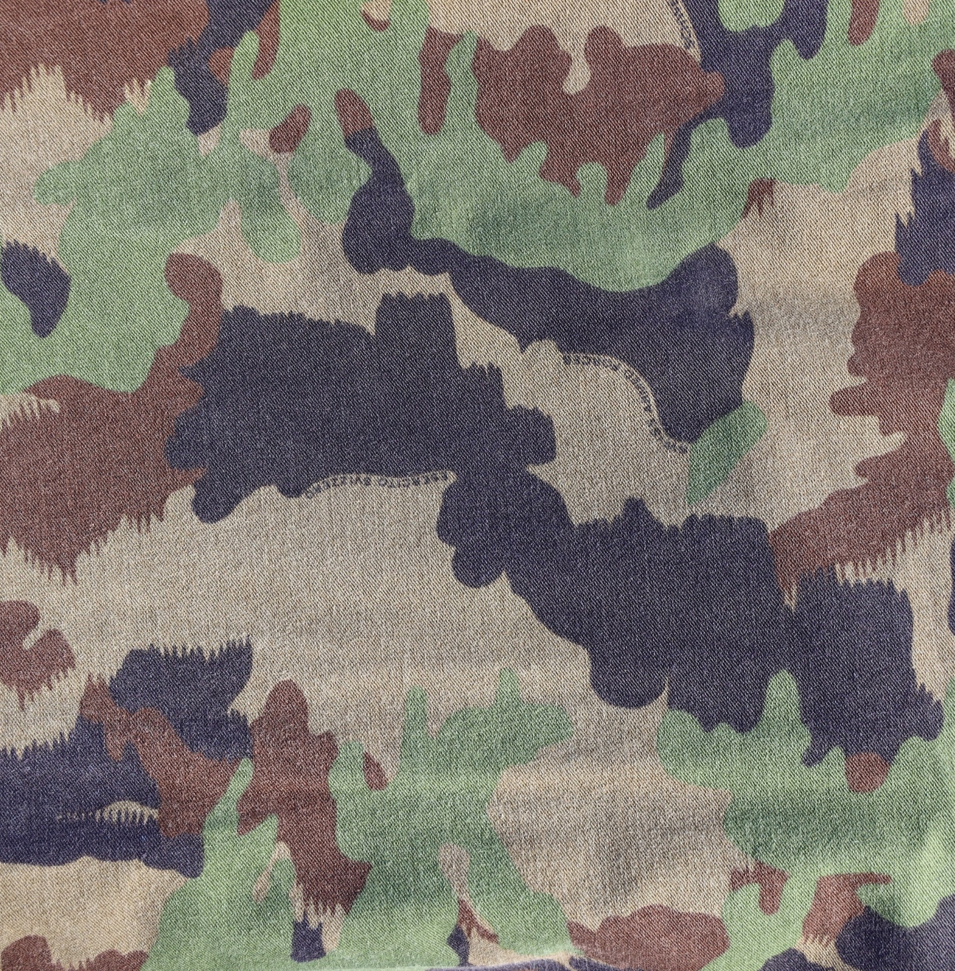
5 ROUNDS
body weight
SQUAT 20x
REVERSE LUNGE 20x
BURPEE 20x
SIT UP 20x

